Slide 1


Company Introduction

Slide 2

Contents
About Acasta
Acasta’s History
Acasta’s Statistics
The Insurers Team
Acasta’s Business Classes
Acasta’s Products
Acasta’s Product Appetite
Acasta’s Technical Capabilities
Acasta’s Sales Platform
Acasta’s Testimonials
Become a Partner
Contact Us
3
4
5
6
7
8
10
11
12
13
14
15

Slide 3



About Acasta
Acasta European Insurance Company Limited is a Gibraltar based insurance company regulated by the Gibraltar Financial Services Commission. Acasta Europe Insurance Company Limited (AEICL) is a 100% subsidiary of Focus Holdings (Gibraltar) Limited (FHGL), an insurance holding company. AEICL distributes business through a range of intermediaries.
We work with a range of partners, including insurance brokers, insurance wholesalers, MGAs, solicitors, third party administrators and warranty providers. We are administered by Acasta Europe Limited.
Growth and partnerships
Since opening in 2006, we have continued to grow, now offering insurance products in 9 different classes. Our comprehensive product portfolio includes Warranty, Motor Add-Ons, Excess Protect and Cycling Insurance. Each product is designed to ensure robust coverage and reliability. By partnering with Acasta, our clients gain access to tailored insurance solutions that suit their clients’ needs, backed by extensive industry expertise and a commitment to exceptional service.
Innovation and flexibility
We adopt an innovative and flexible approach. Therefore, we can both adapt our current products and create new products to meet specific requirements and preferences of our diverse clientele.
Stability and Sustainability
Acasta have continued to boast a stable and sustainable SFCR since 2006, with our key investors and stakeholders ensuring that the business is always equipped for growth and development.

Slide 4
Acasta’s History
2006
2010
2012
2013
2014
2019
2020
2022
2023
Founded, Acasta begins offering Legal Expenses insurance products (ATE).
Expands product range, including Warranty, ASP, and Excess Protection; begins agent partnerships.
Continues diversification in UK and EU with motor ancillary products.
Maintains portfolio stability during COVID; adapts products for post-COVID market.
Launch of our new Sales System that is changing the way our agents work.
2024
Enters General insurance market as a B2B capacity provider.
Diversifies into European General Insurance (GI) market with Motor and ancillary products.
Exits EU market post-Brexit; focuses on UK market. Initiates bespoke insurance software development.
Relaunches modified products post-pandemic; establishes first fronting arrangement, approved by GFSC.
Receives a Gold Award from Insurance Datalab for Underwriting Performance.

Slide 5

Acasta’s Statistics
We have successfully formed strategic partnerships that have helped us to enlarge our customer base and adapt to the evolving market demands. Through continuous innovation and a customer-centric approach, we have expanded our offerings and strengthened our position in the industry. Our growth is a testament to our ability to respond to market changes and provide tailored solutions that meet the diverse needs of our clients. Below is a snapshot of what we have accomplished so far.
£1 Billion +
10 Million +
400,000
Retail Premiums Transacted
Policies Sold
Successful Claims

Slide 6


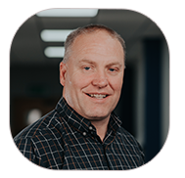
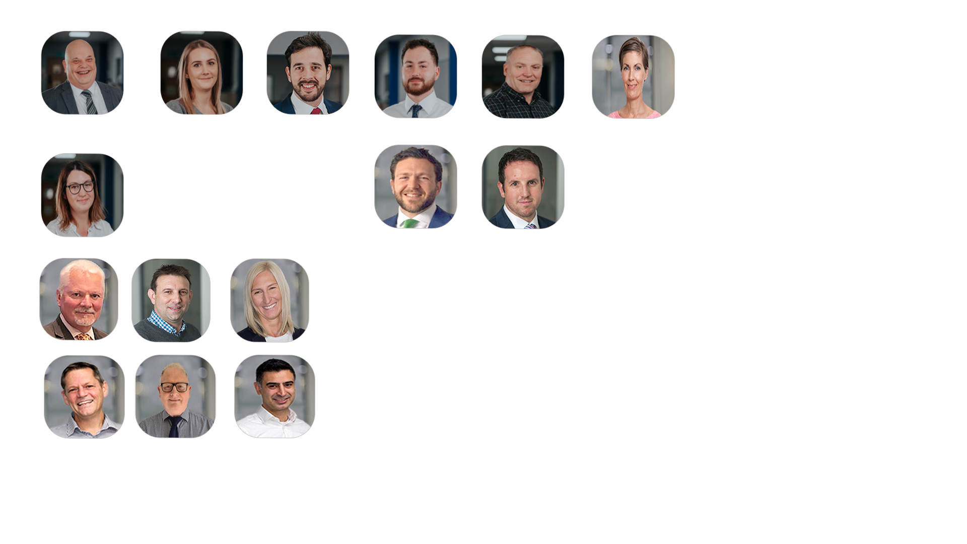

The Team
Mike Gallagher
Chief Executive Officer
Andy Shaw
Underwriting Director
Ruth Mathews
Risk and Compliance Director
James Andlaw
Non-Executive Director
Mike Truran
Non-Executive Director
Michael Lamin
Head of Finance
Gareth Crosbie
Head of Claims
Remi Cosgrove
Head of Underwriting
View the team profiles

Slide 7




Acasta’s Business Classes
Accident
Assistance
Damage to Property
Fire & Natural Forces
General Liability
Legal Expenses
Miscellaneous Financial Loss
Sickness
Suretyship

Slide 8









Acasta’s Products
Accident
Assistance
Damage to Property
Car Hire Excess
SMART Cover
Excess Protection
Also known as Small to Medium Area Repair Technology insurance, this policy covers minor damage to a vehicle such as paint chips, scratches, and dents.
For both motor or home policies, from £250 to £1,000, covering up to 36 months.
Designed to provide coverage for the cost of rental cancellation and personal accidents.
Fire & Natural Forces
General Liability
Legal Expenses
Tyre Insurance
Collision Damage Waiver
Alloy Wheel
Financial protection against
punctures, blowouts, or damage caused by road hazards.
For losses from damage to a rental car.
Covers the cost of repairing or replacing damaged alloy wheels on a vehicle.
Sickness
Suretyship
Motor Breakdown Cover
MOT Insurance
Motor Warranty
Covers the cost of repairs or replacements needed to pass an MOT test.
Protects against the cost of mechanical or electrical faults that arise after the manufacturer's warranty has expired.
Provides 24/7 assistance, including home starts and claims abroad.

Slide 9









Acasta’s Products
Accident
Assistance
Damage to Property
Key Cover
Brown & White Goods Warranty
Cycle Insurance
Protects customers against the cost of replacing lost, damaged, or stolen keys.
Covers the cost of repairing or replacing electrical and electronic appliances such as refrigerators, washing machines, televisions, and computers.
Covers the cost of repairing or replacing a bicycle in the event of theft or accidental damage.
Furniture Warranty
Wedding Insurance
Helmet & Leathers Insurance
Protection against defects and damage that may occur to the furniture during the warranty period.
Includes wedding cancellation or rearrangement, loss or damage to attire, gifts, rings, flowers, cake, cars, transport, photography, video, and service suppliers.
Designed to provide coverage for the protective gear worn by motorcyclists in the event of damage or loss.
Rent Guarantee
Home Emergency
Caravan
Landlord protection against the loss of rental income if tenants fail to pay their rent.
Covers the costs of urgent repairs in your home due to unexpected issues.
Protects your caravan against various risks and potential damages .

Slide 10
Acasta’s Product Appetite
Product
Licenced to Write
Currently Offer
Able to Consider
Home Emergency
Yes
No
Yes
Misfuel
Yes
No
Yes
Early Termination
Yes
No
Yes
Home Buyers (Gazumping)
Yes
No
Yes
Tools in Transit
Yes
No
Yes
Rent Guarantee
Yes
No
Yes
Jewellery Asset Protection
Yes
No
Yes
Golf Club Asset Protection
Yes
No
Yes
Travel
Yes
No
Yes
Legal Expenses
Yes
No
No
After The Event
Yes
No
No
Income protection (Mortgage, Loan, Bill, Income, Credit Card)
View Insurers Team profiles
Yes
No
No
Tailored Products
We are happy to consider other products not on this list subject to Acasta being licensed to write these products and that it meets our commercial requirements.

Slide 11
Acasta’s Technical Capabilities
Advanced Underwriting Capabilities
With tailored underwriting systems and tools, our underwriting team focuses on all financials, predictive analysis, performance, emerging trends, and product analysis with a particular focus on customer outcomes. Managing multiple lines and classes of business, they can reintroduce distressed products to the market by leveraging sufficient and justifiable data, enabling you to provide your clients with a unique offering. They engage in reinsurance arrangements with A-rated insurers to suit your needs, ensuring competitive risk management and optimal cover.
Comprehensive Claims Management
Our in-house claims team is managed by the Head of Claims in the UK and Gibraltar. The team has a custom-built and designed claims management system to communicate with customers. Acting as a CRM system, it is also linked back to the insurer's main database, providing instant updates on the progress of the claim on the original policy file. We have long-standing relationships with expert external service providers and repair networks, facilitating a simplified claims process.
Rigorous Compliance Standards
Our compliance team adheres to the rigorous standards set by the PRA and FCA. They ensure that all our operations comply with regulatory requirements and industry best practices. The team is also responsible for implementing internal policies and procedures to mitigate risk and maintain ethical standards. Regular audits and assessments are conducted to ensure ongoing compliance and to address any areas of concern promptly.
Data Management and Analytics
Our data team, who manages and maintains our internal database, are responsible for overseeing all customer data and analytics. The team collaborate with our underwriting team to determine the pricing of products, ensuring they offer fair value and are aligned with market trends. This allows us to maintain competitive pricing and tailor policies and procedures to your businesses while delivering high quality products.

Slide 12
Acasta’s Sales Platform
In line with the future of insurance business operations, our team have developed a new and advanced sales system that is changing the way our agents work, providing efficiency and innovation.
Key System Features:
Rapid set up – get started quickly with ready to go products or sell bespoke products.
Comprehensive automation – From initial quoting to policy inception, document distribution and ongoing policy management, the system minimises manual intervention.
Secure data management – ensure all data is managed securely, adhering to Cyber Essentials Plus requirements.
API capabilities – API capabilities that can integrate with your existing systems seamlessly.
Full branding control – white labelling to ensure you can maintain your brand identity, including logos, colours and domains.
Full lifecycle management – One platform that manages rates, policy inception, document distribution, MTAs and cancellations.
Acasta holds Cyber Essentials Plus certification, which reflects our commitment to data security. Throughout the development journey, measures have been implemented to protect the integrity and confidentiality of data at every stage.

Slide 13


Acasta’s Testimonials
We have been working with Acasta since 2018 and find that both their product offering and support provided are second to none.
Throughout the business, you will find the same professional and approachable culture. This, coupled with their openness to discussing new ideas and lines of business, is very refreshing within the industry, and we look forward to continuing to grow our partnership into the future.
Matt Eland, Operations Director at Direct GAP
In April 2020 and like many other providers Voyager Insurance Services Ltd had to withdraw its award-winning Wedding Insurance product ‘Dreamsaver’ from the market. After carefully considering a number of alternative Insurance Markets we decided to Partner with ACASTA Europe Limited. Our decision to work with ACASTA had been made easy by the flexible approach taken by their underwriting team which has allowed us to re-launch our product providing improved insurance coverage to meet the changing needs of customers in a market that is currently lacking choice.
Whilst working with ACASTA and throughout the underwriting process we received a prompt and efficient service and a combination of questions and support that challenged our proposition and helped improve coverage beyond that on offer when the product achieved its award-winning status prior the outbreak of the pandemic. We are delighted to be working with ACASTA and very much look forward to developing our new business relationship with them in the years ahead.
Steve Cox, Managing Director at Voyager Insurance

Slide 14
Become a partner
As underwriting specialists, our goal is to ensure that your business has the best possible solutions and support to thrive in a competitive market, offering you comprehensive and tailored insurance products that meet your specific needs.
New Schemes
If you’re looking for a new scheme but can’t find one that fits, we can help create one for you. Our underwriters have the experience to bring your vision to life.
Existing Schemes
We can review your existing schemes and help improve them. If you are not satisfied with what you are currently offering your clients, we will work with you to create the perfect solution.
Application Process
Once we receive your application, our team will contact you to discuss the specific details required for each scheme. We believe in building personal relationships with our clients and underwriters throughout this process and beyond. We provide rates and policy documents tailored to your business. Any necessary amendments will be discussed to ensure that the policies meet your exact requirements.
Systems
We provide full support with our Sales platform, ensuring that you have the assistance that you need to maximise its potential and drive business growth.
Support and Assistance
We assist you with the systems and procedures needed to bring your scheme to life. Our team is here to help every step of the way. If required, we can help you source a reliable claims handler to manage claims efficiently.

Slide 15



Contact Us
Want to know more about how we can help you provide a unique offering for your clients? Start by filling out our quick and easy application form available on our website or get in touch with our team today:
Submit an Application Form
Acasta Europe Insurance Company Limited
Phone: +350 2007 4684
Email: info@acastainsurance.gi
Website: www.acastainsurance.gi
Acasta Europe Limited
Phone: 0800 668 1350
Email: info@acastaeurope.co.uk
Website: www.acastaeurope.co.uk

Slide 16
Exclusively administered by
info@acastainsurance.gi | 0034 635 790054 | www.acastainsurance.gi

